Slide 1
Log into the VMs
For windows

Slide 2
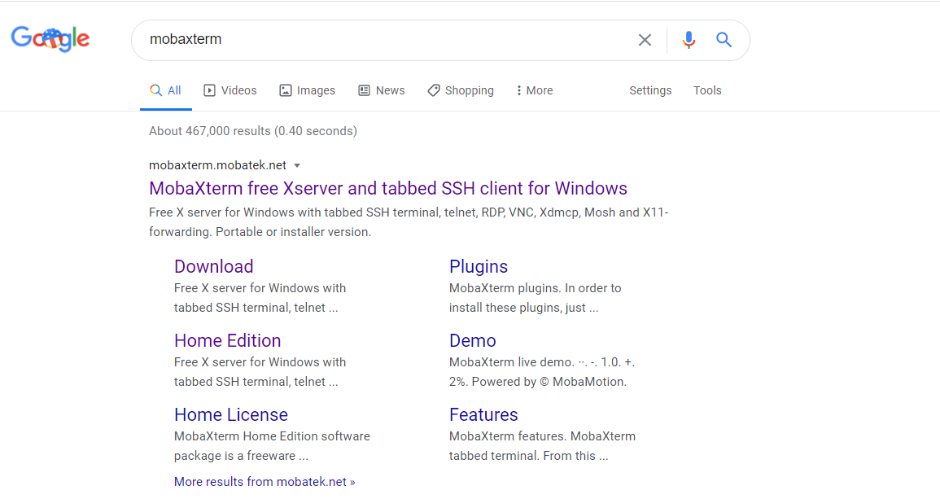
Step 1: Get MobaXTerm

Slide 3
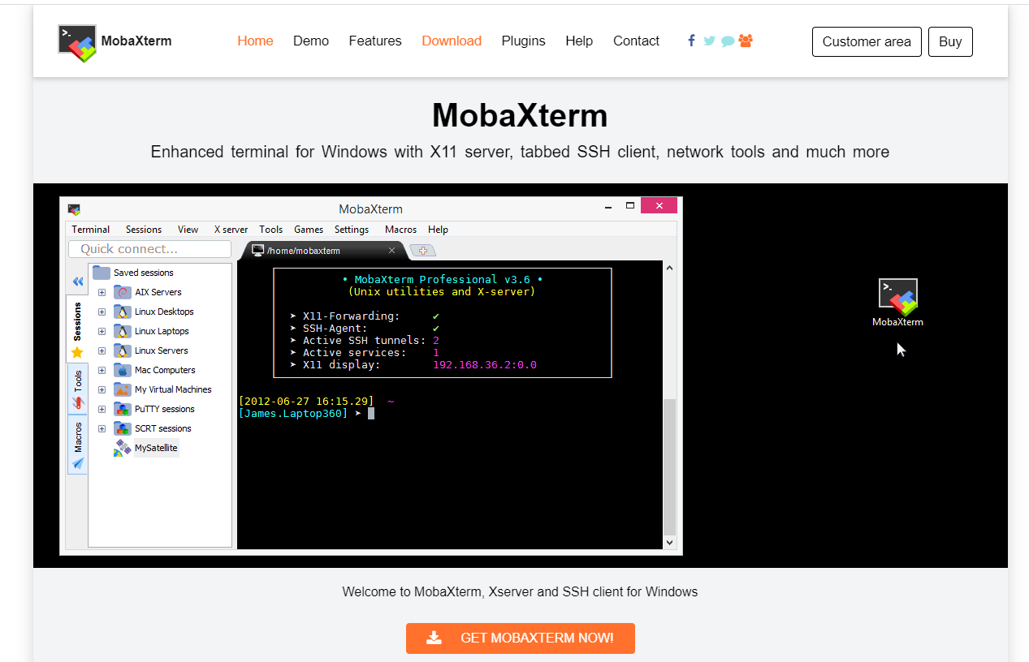
Step 1: Get MobaXTerm

Slide 4
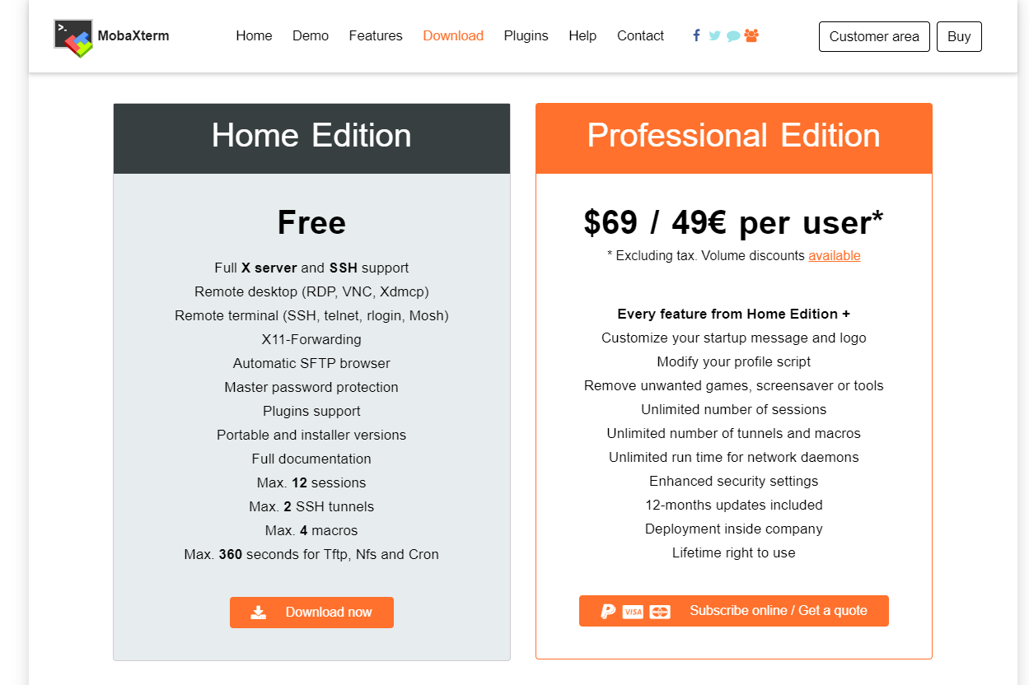
Step 1: Get MobaXTerm

Slide 5
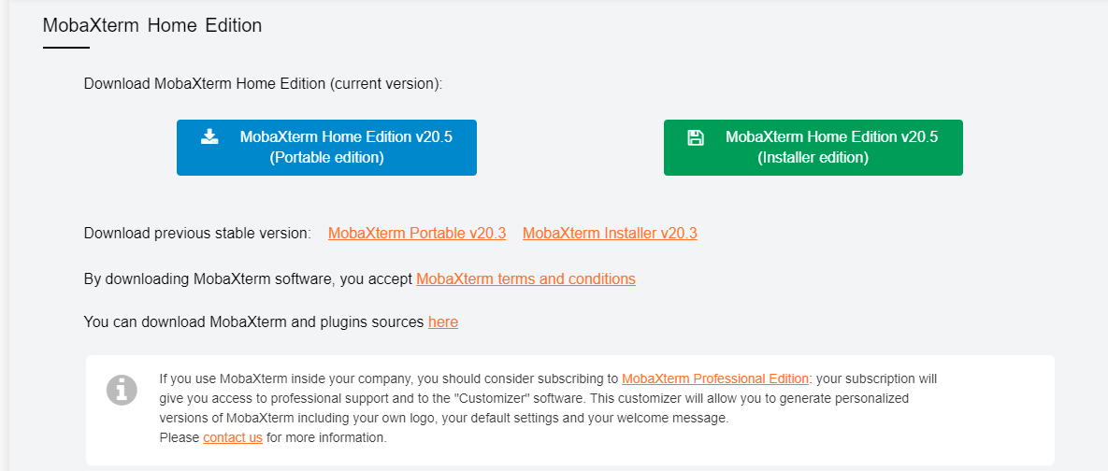
Step 1: Get MobaXTerm

Slide 6
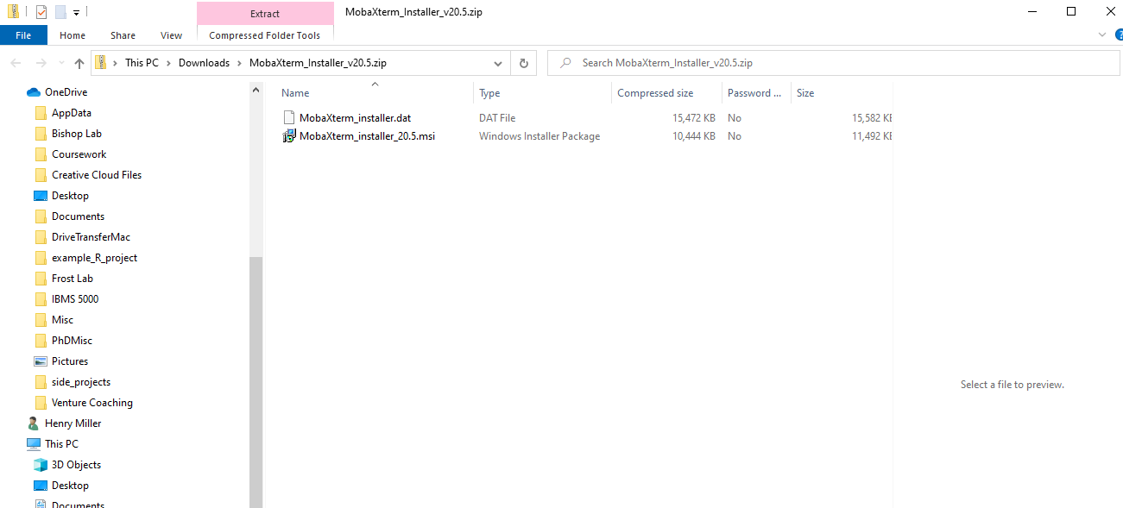
Step 1: Get MobaXTerm

Slide 7
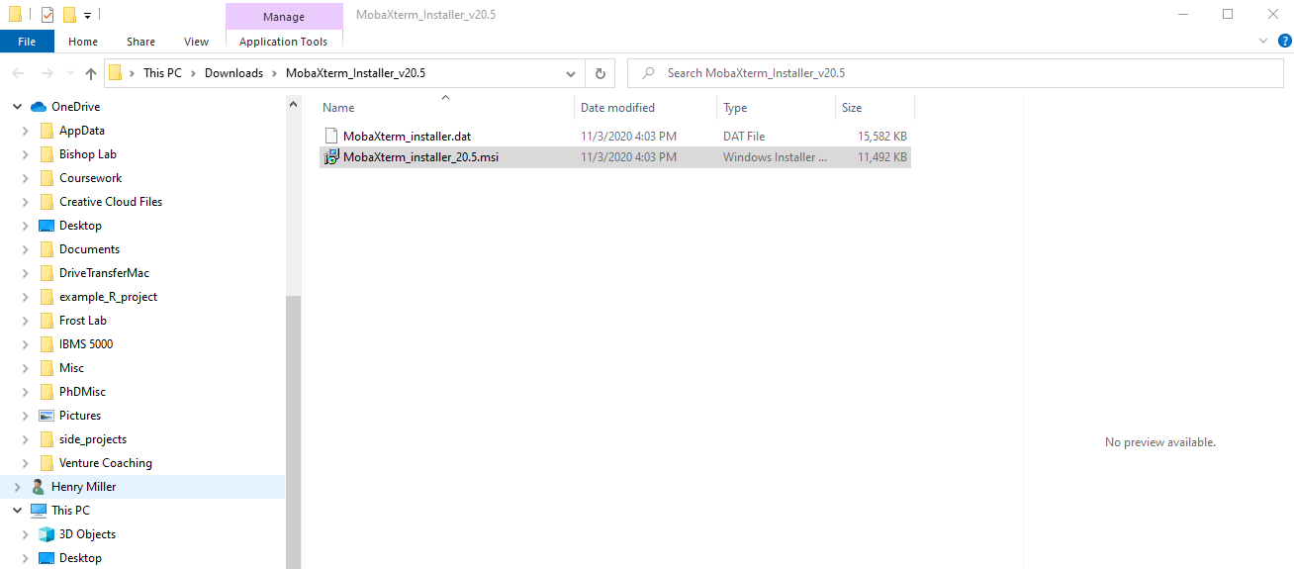
Step 1: Get MobaXTerm

Slide 8
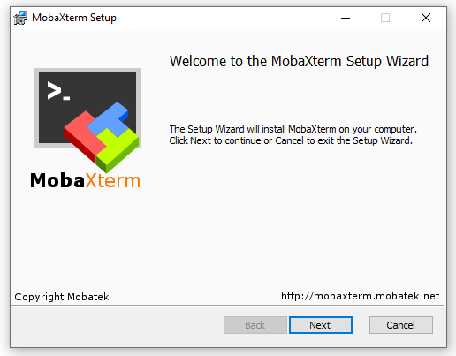
Step 1: Get MobaXTerm

Slide 9
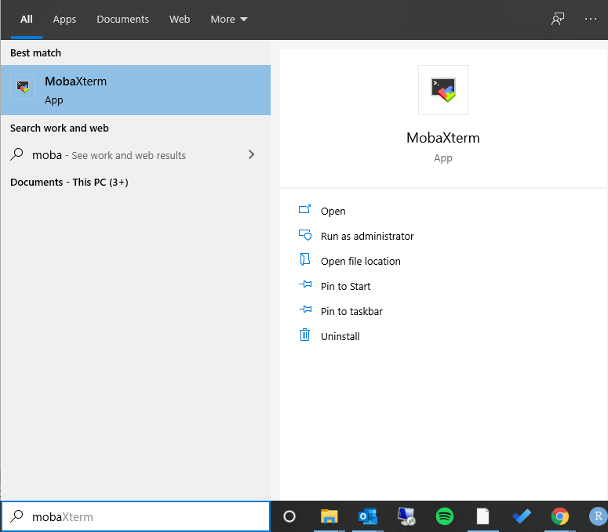
Step 2: Set up MobaXTerm for VM access

Slide 10
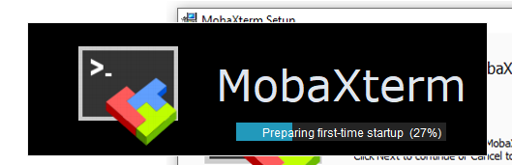
Step 2: Set up MobaXTerm for VM access

Slide 11
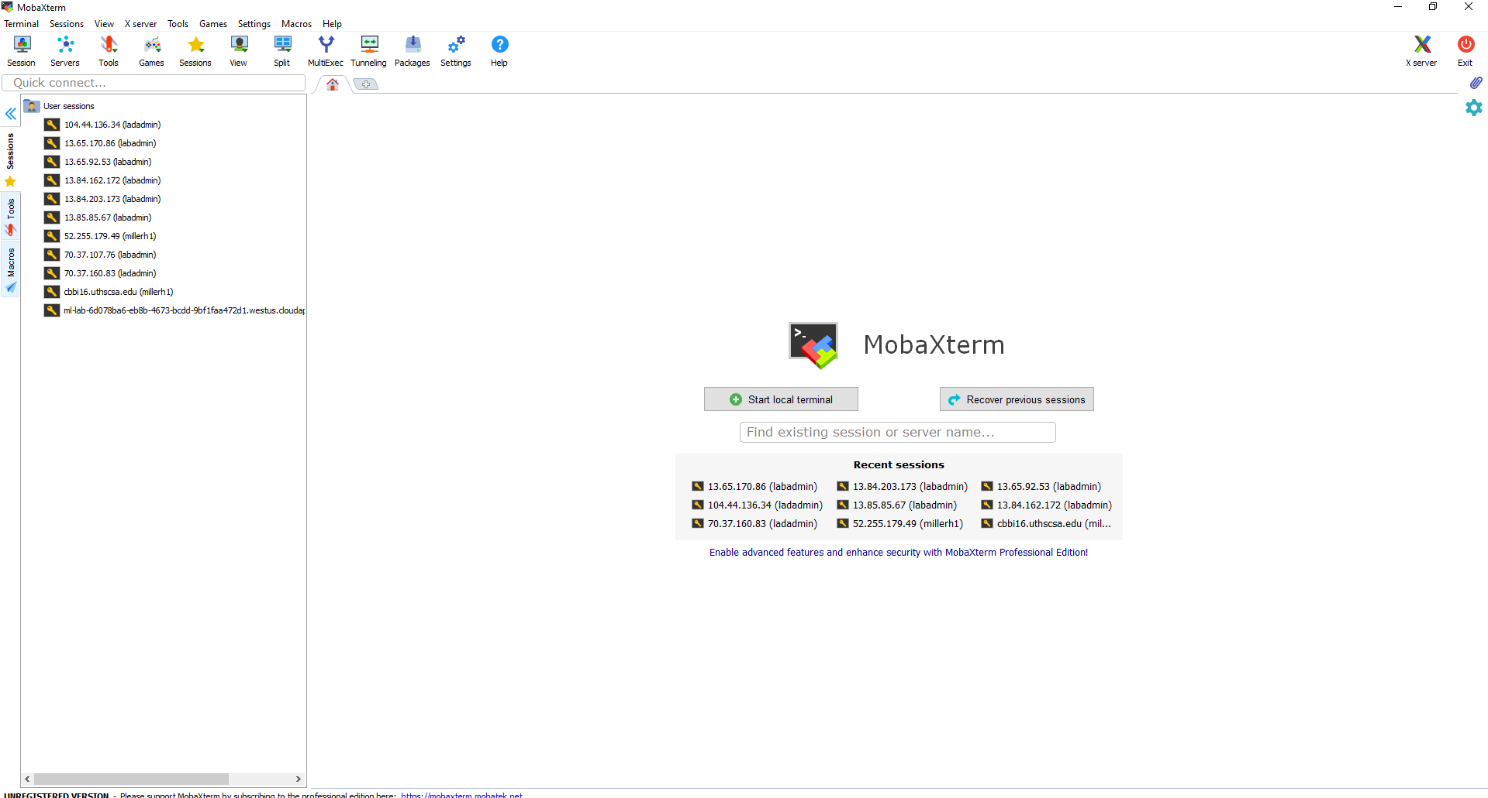
Step 2: Set up MobaXTerm for VM access

Slide 12
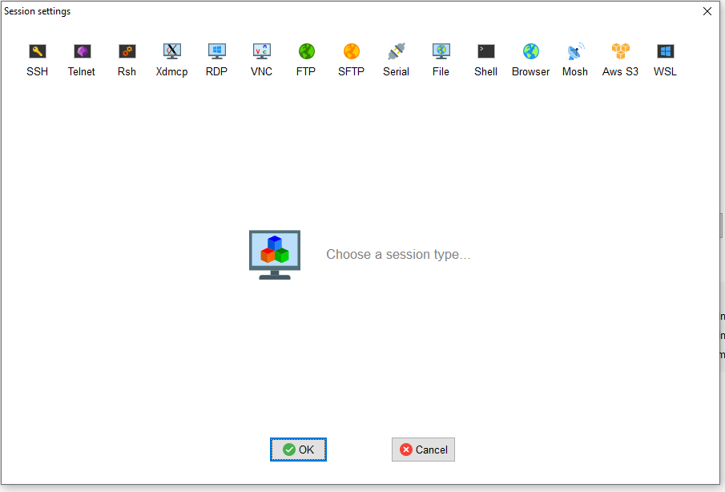
Step 2: Set up MobaXTerm for VM access

Slide 13
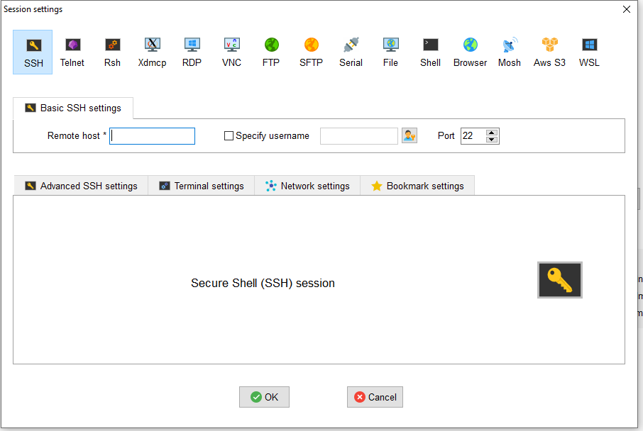
Step 2: Set up MobaXTerm for VM access

Slide 14
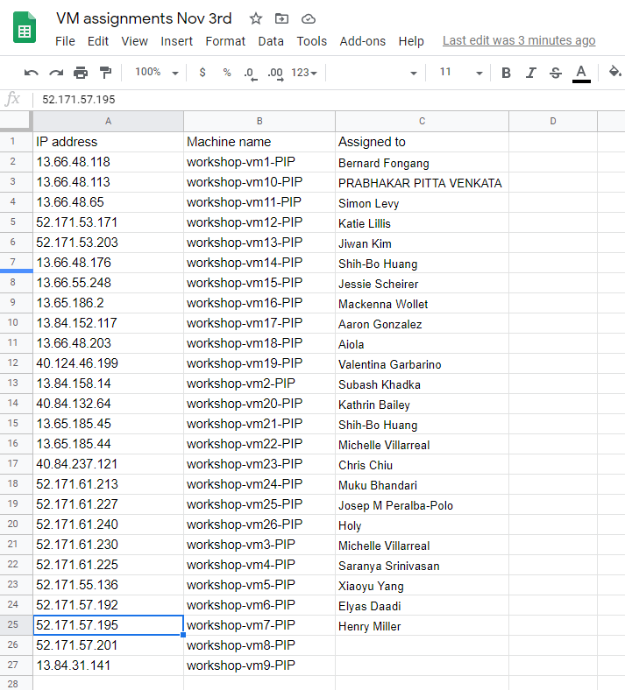
Step 2: Set up MobaXTerm for VM access

Slide 15
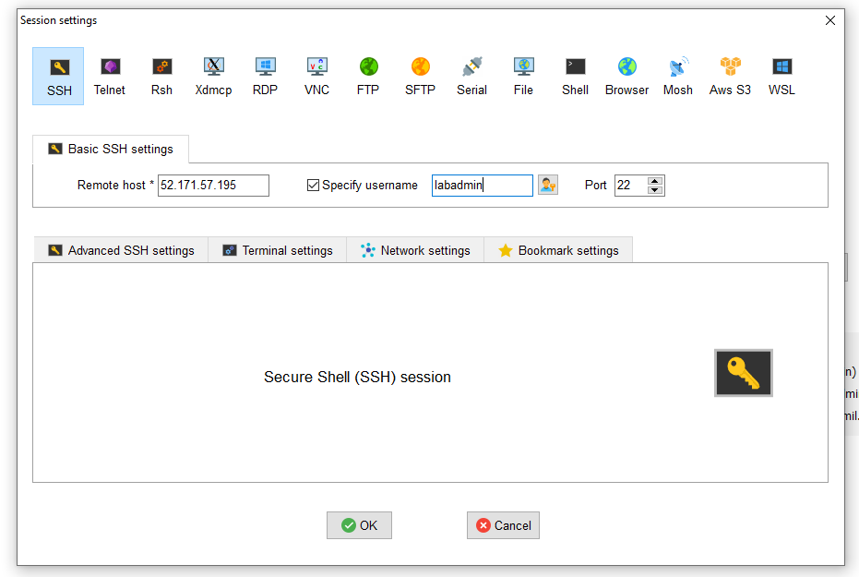
Step 2: Set up MobaXTerm for VM access
Remote host is IP address
Username for everyone is “labadmin”

Slide 16
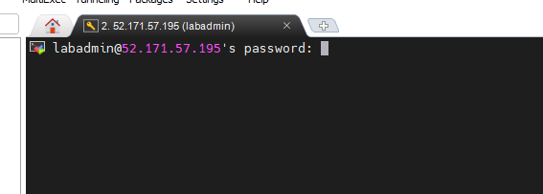
Step 2: Set up MobaXTerm for VM access
Type or paste !L1nuxL@bT3$t! and hit <enter> BEWARE: you won’t see the text; you must trust it is there
BEWARE2: The password must not have a space at the end (be careful how you copied it)

Slide 17
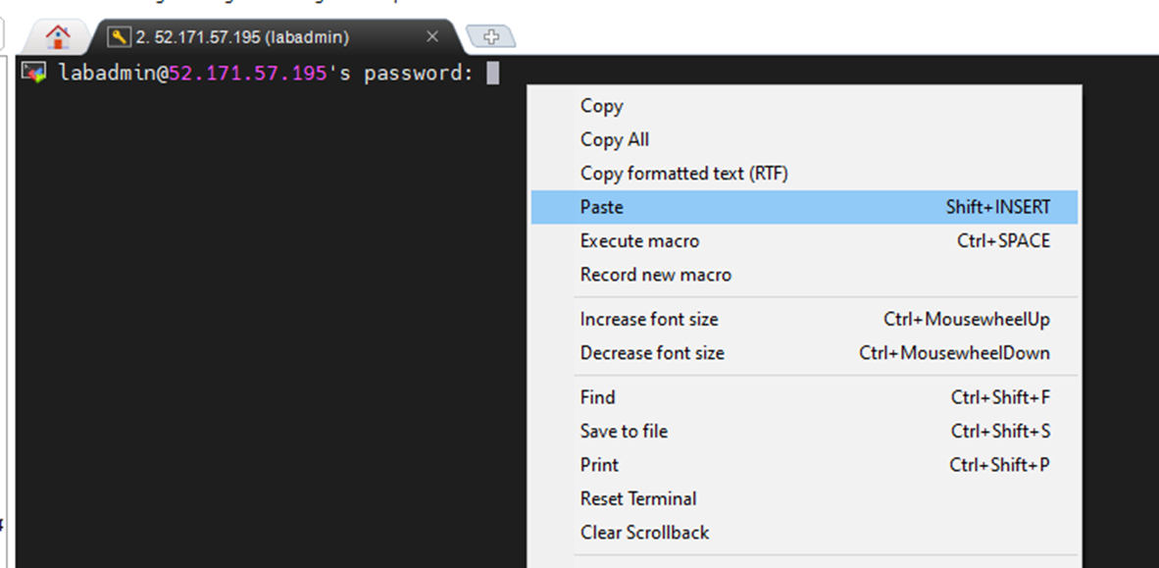
Step 2: Set up MobaXTerm for VM access
Type or paste !L1nuxL@bT3$t! and hit <enter> BEWARE: you won’t see the text; you must trust it is there
BEWARE2: The password must not have a space at the end (be careful how you copied it)

Slide 18
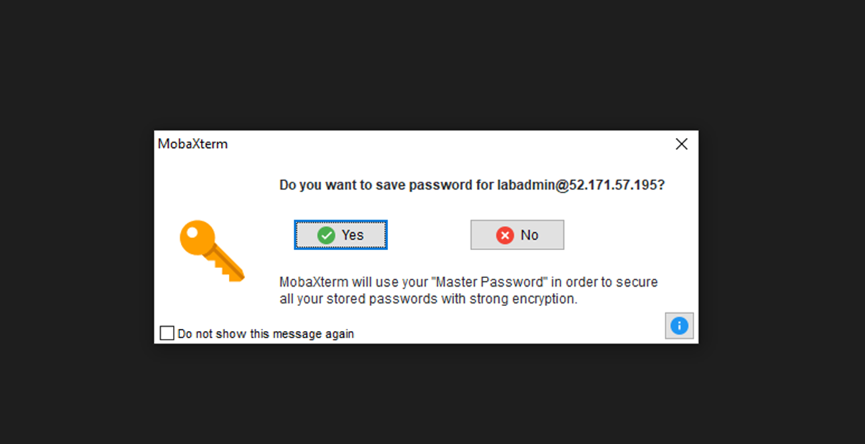
Step 2: Set up MobaXTerm for VM access

Slide 19
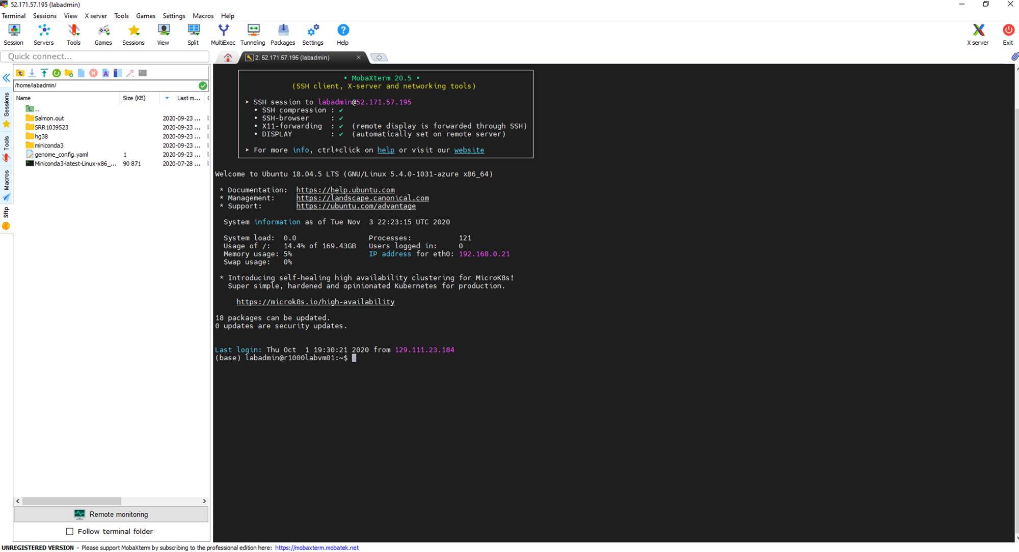
Success!!

